Slide 1
Credit Card Fraud Detection

Slide 2

Importance of Fraud Detection
Fraud detection is essential to protect customers from unauthorized transactions.
It helps financial institutions avoid financial losses and maintain customer trust.
Efficient fraud detection systems can prevent future fraudulent activities.
2

Slide 3
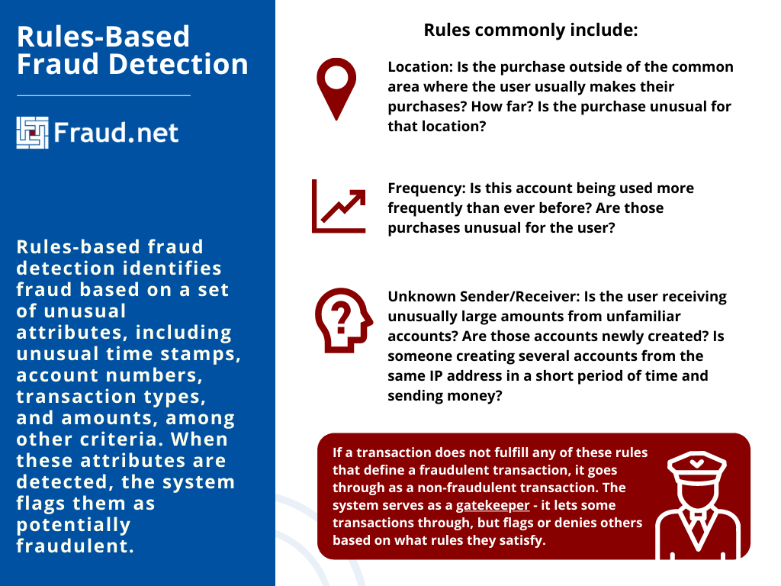
Traditional Fraud Detection Methods
Manual review and analysis of transactions by human experts.
Rule-based systems that flag suspicious activities based on predefined rules.
Statistical models that identify anomalies by analyzing transaction patterns.
3

Slide 4
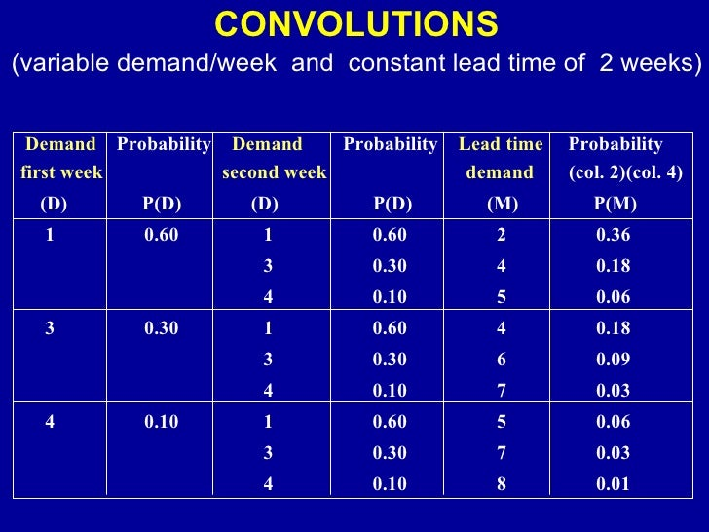
Limitations of Traditional Methods
Manual reviews are time-consuming and may result in delays and false positives.
Rule-based systems are limited by their inability to adapt to emerging fraud patterns.
Statistical models may generate false positives or miss sophisticated fraud patterns.
4

Slide 5
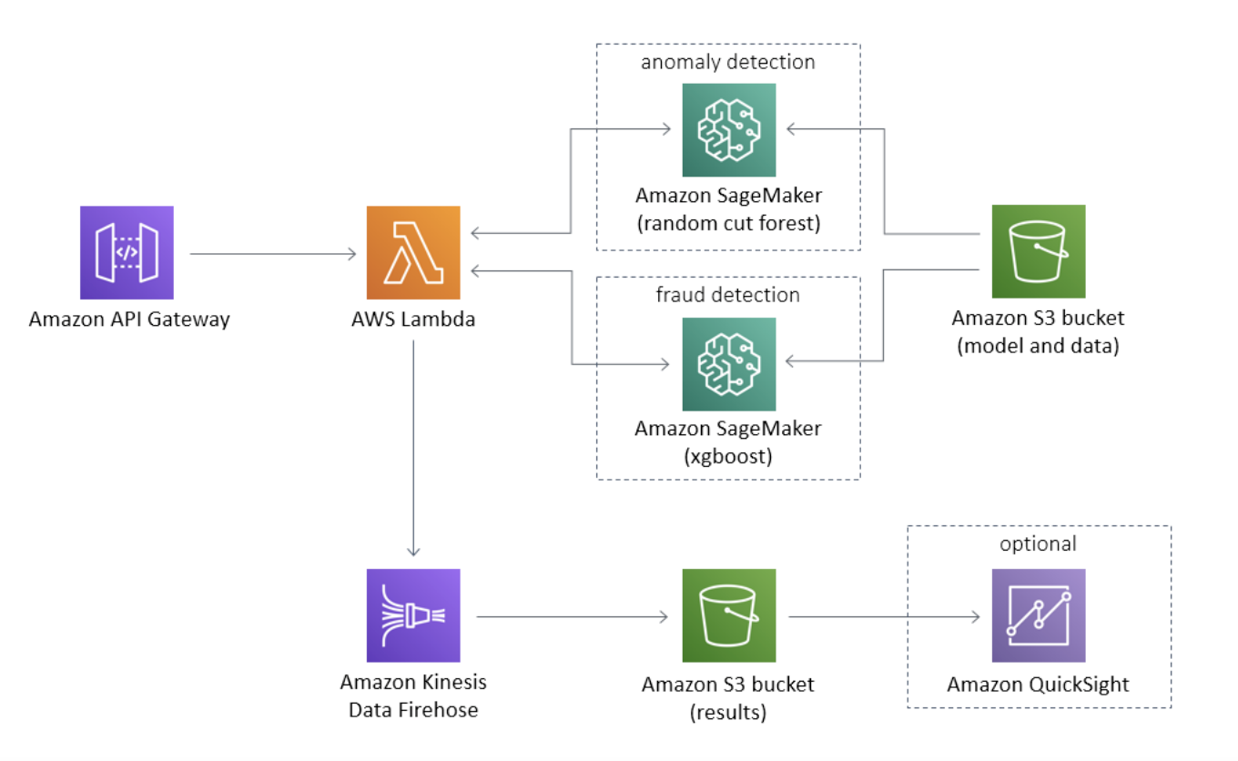
Machine Learning in Fraud Detection
Machine learning algorithms can analyze large volumes of data to detect patterns.
Supervised learning algorithms can classify transactions as fraudulent or genuine.
Unsupervised learning algorithms can identify anomalies in transaction patterns.
5

Slide 6
Key Components of Machine Learning-based Fraud Detection
Data preprocessing: Cleaning, transforming, and preparing data for analysis.
Feature engineering: Selecting relevant features to improve model performance.
Model training: Training the machine learning model on labeled data.
6

Slide 7
Fraud Detection Techniques
Neural Networks: Deep learning models that can learn complex patterns.
Random Forests: Ensemble models that combine multiple decision trees.
Logistic Regression: Statistical model to predict fraud probability.
7

Slide 8

Real-time Fraud Detection
Real-time monitoring of transactions to detect and prevent fraud immediately.
Advanced technologies like AI and machine learning enable quick analysis.
Integration of fraud detection systems with payment gateways for instant response.
8

Slide 9
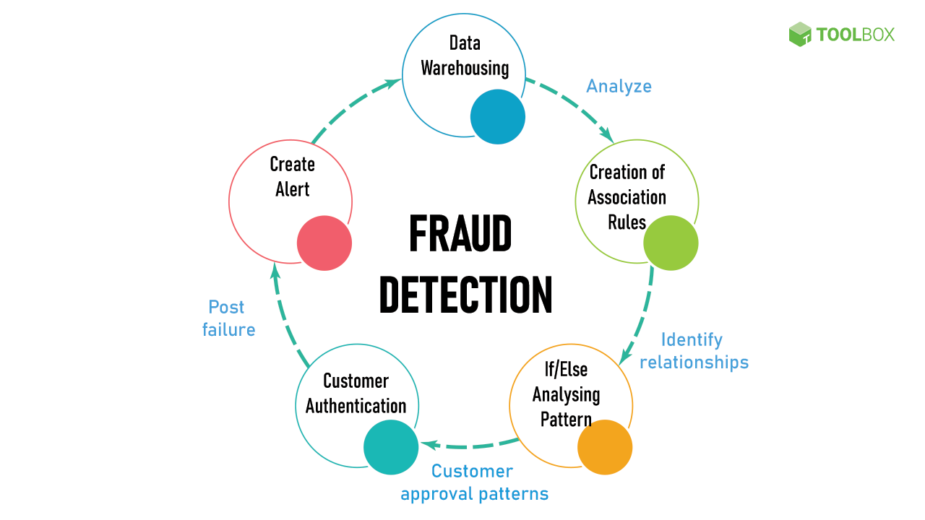
Fraud Detection Challenges
Evolving fraud techniques require continuous updates to detection systems.
Balancing fraud detection accuracy with minimizing false positives.
Ensuring compliance with privacy regulations while analyzing customer data.
9

Slide 10
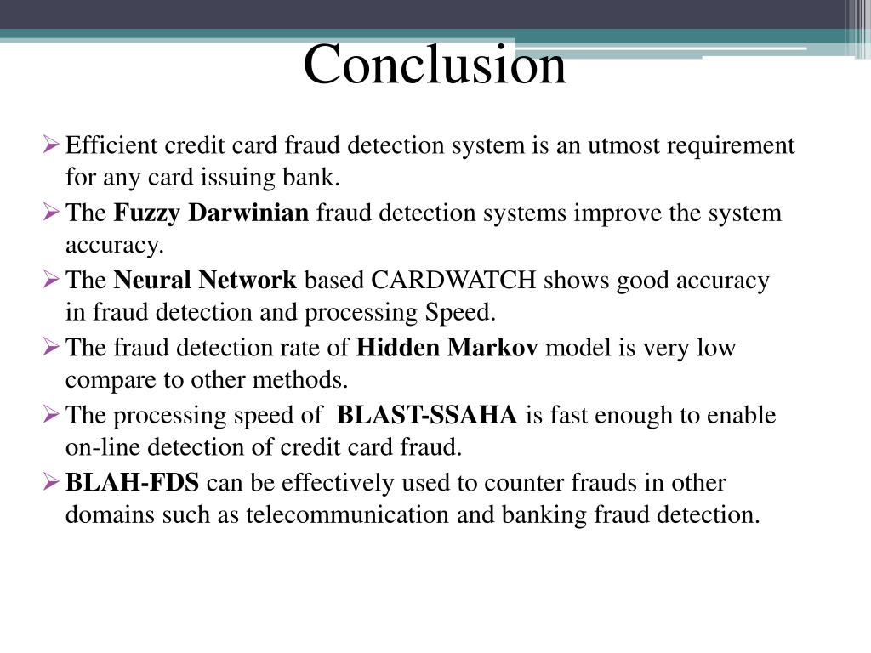
Conclusion
Credit card fraud detection is a critical aspect of financial security.
Machine learning-based approaches offer enhanced accuracy and efficiency.
Continuous innovation and adaptation are necessary to stay ahead of fraudsters.
10

